Slide 1

Flower Classifier
A presentation on using Convolutional Neural Networks for flower classification.
by Celine Antrazi

Slide 2
What is a CNN?
A Convolutional Neural Network (CNN) is designed to work with data that has a grid topology (images). A CNN learns spatially localized patterns. It slides learnable filters over the input producing feature maps. It is used to detect and classify objects.
Key Concepts
Application
Convolution
Image classification
Feature Maps
Object detection
Filters
Image recognition

Slide 3

Problem
Design a reliable image classification system. Given a single RGB photograph, identify its species as one of five classes. The classes are daisy, dandelion, rose, sunflower, and tulip.
Subtle Visual Differences
Variable Conditions
Limited Data

Slide 4




Target Users
The flower classifier system is intended to be used for multiple applications. Target users include hobbyists, e-commerce florists, agricultural teams, and educational apps.
Home Gardeners
E-commerce Florists
Learn flower names and basic care tips.
Speed up product cataloging and search.
Agriculture Monitoring
Track flowering stages and crop health.

Slide 5

Why it Matters
This project improves operation, engagement, ROI, and provides a societal benefit. Real-time feedback keeps gardeners engaged. Scalable monitoring supports conservation and initiatives.
Efficiency
Eliminate manual image labeling.
Engagement
Real-time feedback improves engagement.
Societal Benefit
Floral biodiversity supports conservation.

Slide 6




Business Value
This classifier provides strong business value by increasing efficiency and engagement. Additionally, new revenue can be made by monetizing premium features.
Cost Savings
Efficiency Gains
Enhanced Engagement

Slide 7




Why CNN?
CNNs are the best fit for image classification. They handle spatial features well. Flowers are visual, which makes CNNs an optimal choice.
Visual Data
Flowers are visual.
Spatial Features
Handles petal shapes.
Image Classification
Best fit for images.

Slide 8
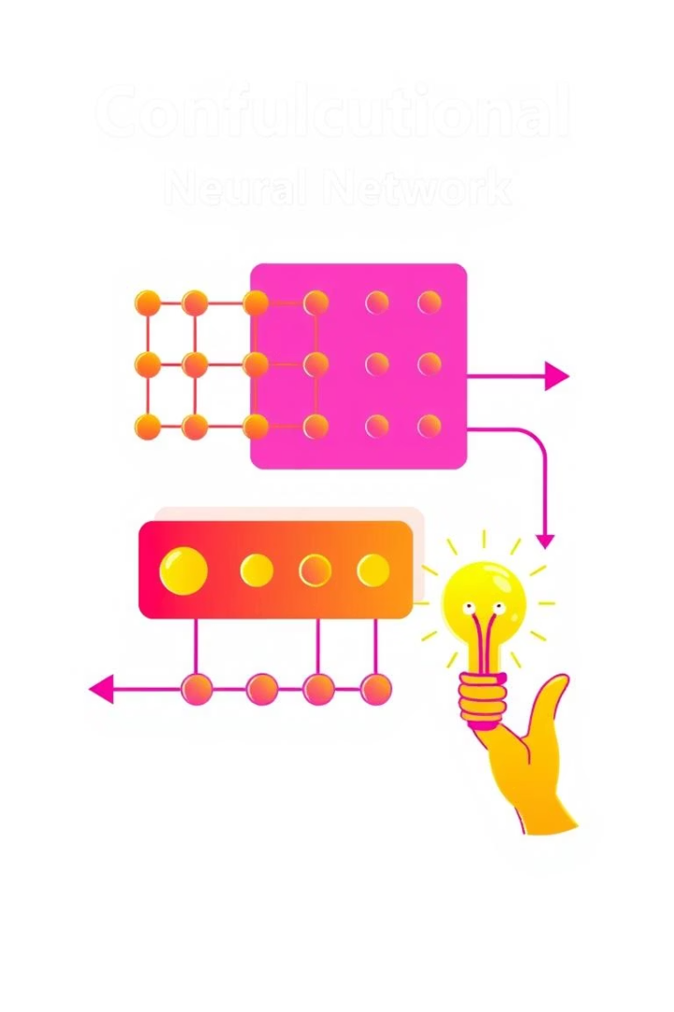
Parts of CNNs
CNNs have multiple parts that allow the network to detect and classify different objects. Convolution and pooling layers help extract spatial features. Activation functions allow the network to model complex patterns.
1
Convolution Layers
Extract spatial features.
2
Non-linear Activations
Model complex patterns.
3
Pooling Layers
Reduces spatial dimensions.
4
Batch Normalization
Stabilizes training.

Slide 9

Dataset
The dataset comes from Kaggle. It includes approximately 4,000 photographs in total. There are 5 different classes. Each class has about 800 images.
4K
5
Total Images
Number of Classes
800
Images Per Class

Slide 10




Preprocessing Steps
The first step loads and splits the data. It augments training images. Normalization occurs via a "Rescaling" layer. The tf.data pipeline is optimized to speed up training.
Load & Split
Augment Training
1
2
4
3
Optimize
Normalize

Slide 11
Model Architecture Summary
Input Layer
128 × 128 × 3 RGB image tensor
Convolution & Pooling Blocks
Conv2D: 32 filters, 3×3 kernel, padding=“same” – Activation: ReLU – MaxPool2D: 2×2
Conv2D: 64 filters, 3×3 kernel, padding=“same” – Activation: ReLU – MaxPool2D: 2×2
Conv2D: 128 filters, 3×3 kernel, padding=“same” – Activation: ReLU – MaxPool2D: 2×2
Classification Head
Flatten: converts 16×16×128 → 32 768-dim vector
Dense: 128 units – Activation: ReLU – Dropout: 0.5
Dense (Output): 5 units (one per flower class) – Activation: Softmax → class probabilities

Slide 12
Model Architecture Summary
Input Layer
128 × 128 × 3 RGB image tensor
Convolution & Pooling Blocks
Conv2D: 32 filters, 3×3 kernel, padding=“same” – Activation: ReLU – MaxPool2D: 2×2
Conv2D: 64 filters, 3×3 kernel, padding=“same” – Activation: ReLU – MaxPool2D: 2×2
Conv2D: 128 filters, 3×3 kernel, padding=“same” – Activation: ReLU – MaxPool2D: 2×2
Classification Head
Flatten: converts 16×16×128 → 32 768-dim vector
Dense: 128 units – Activation: ReLU – Dropout: 0.5
Dense (Output): 5 units (one per flower class) – Activation: Softmax → class probabilities

Slide 13
Training Process
- Compile
- Loss: `SparseCategoricalCrossentropy`
- Optimizer: `AdamW` (learning rate 1 × 10⁻³)
- Metric: `Accuracy`
- Hyperparameters
- Batch size: 32
- Epochs: 10
- Validation
- 20 % hold-out split via `image_dataset_from_directory(validation_split=0.2)`
- Validation metrics computed at end of each epoch
- Outputs
- Per-epoch train/val loss & accuracy curves
- Final validation accuracy: 69.22 %

Slide 14
Training/Testing Split
Ratio: 80 % training / 20 % validation
How:
Used tf.keras.utils.image_dataset_from_directory with
validation_split=0.2
subset='training' / 'validation'
seed=42 (ensures the same split every run)
Resulting Sizes:
Training set: ~2 197 images
Validation set: ~549 images
Purpose:
Training set—to fit model weights and learn patterns
Validation set—to monitor generalization, tune hyperparameters, and detect overfitting during training

Slide 15
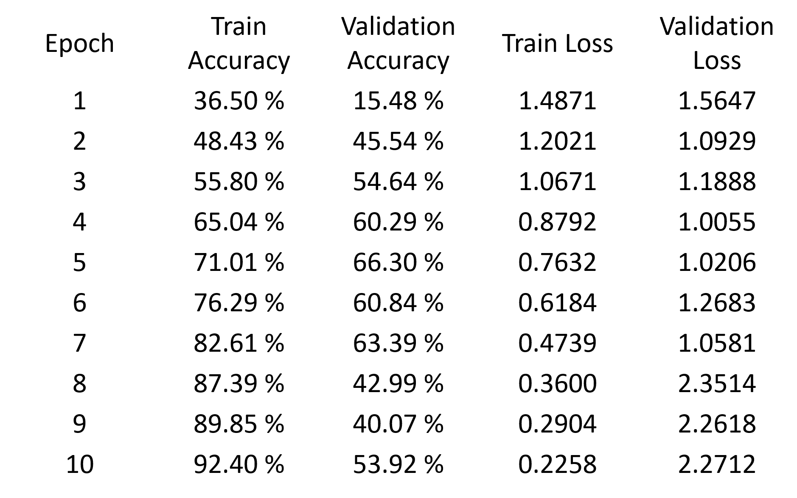
Training vs. Validation Performance

Slide 16
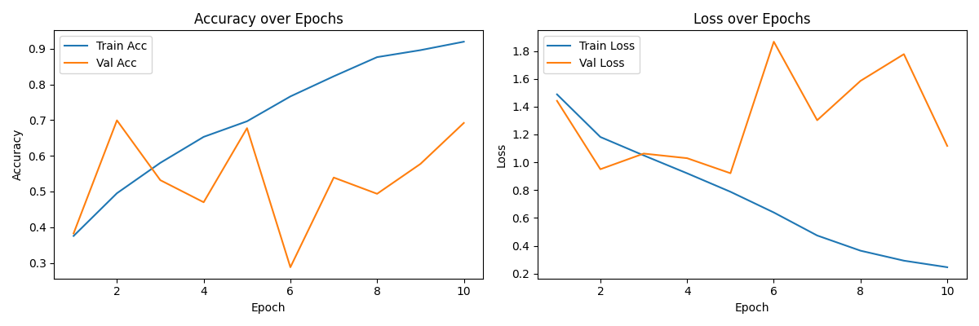
Accuracy vs. Loss Curves

Slide 17
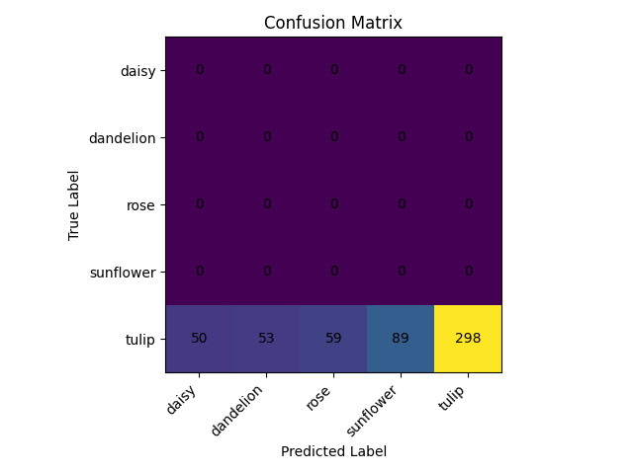
Confusion Matrix

